Slide 1


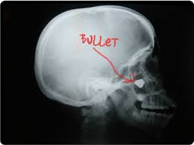
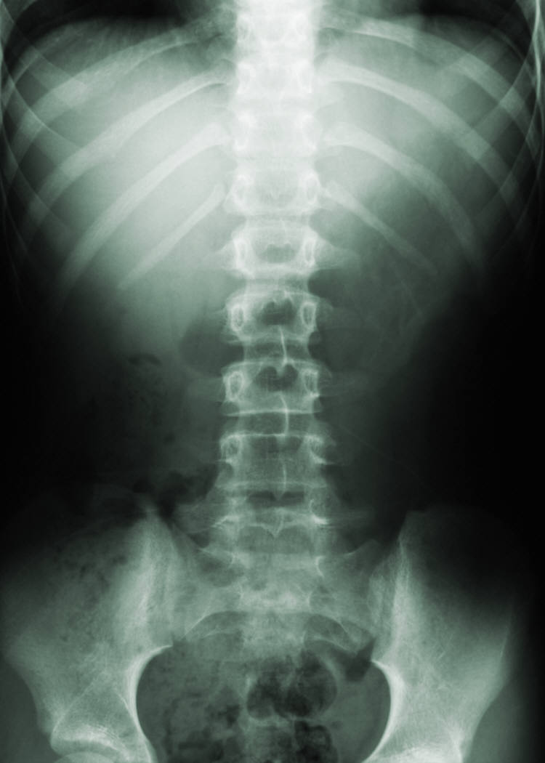
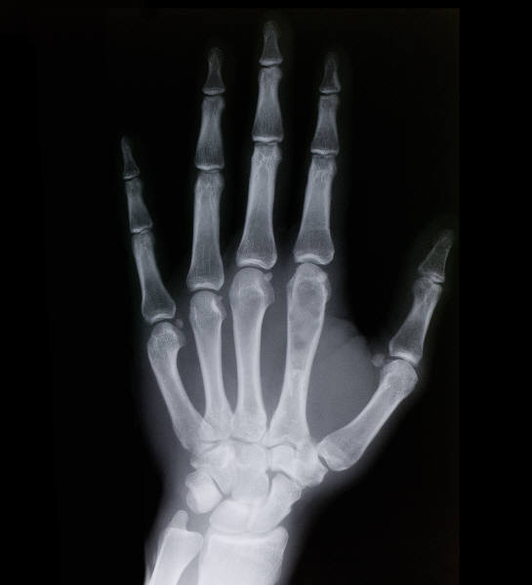

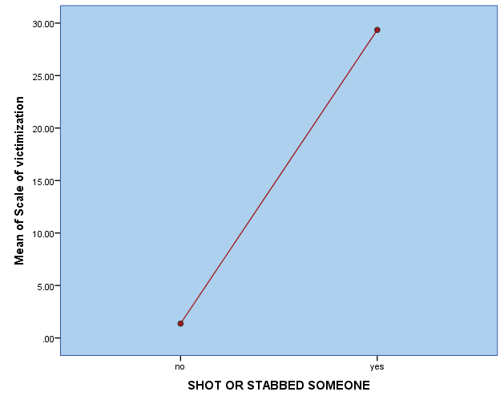
Violence: A Public Health Approach to Prevention
￼
Gina M. Gerace
California State University, Chico
INTRODUCTION
Violence is a major public health issue that has traditionally been analyzed from a criminal justice perspective.
While violence is certainly a criminal justice issue, it is important to study violence from a public health standpoint.
The criminal justice model uses punishment to deter people from behaving violently- but what about those who commit violent acts against themselves such as attempting or committing suicide? Or inmates who emerge from prison more hardened, volatile and desensitized to committing violent acts? What if violence were treated like a contagious disease? Certainly we wouldn’t punish someone for being ill. By addressing violence using a public health based disease model, we can focus on the casual (contagious) aspect of violence in hopes of finding a possible cure instead of retributive justice based on punishment.
Violence is not always a crime, but it is always a public health concern.
BACKGROUND
The literature suggests that violence is often a vicious cycle of trauma and abuse which results in a victim of violence later becoming a perpetrator of violence. This is most classically seen in child abuse and gang related violence. (Cullen et al., 2005).Some scholars believe that an individual who has been subjected to violence, in an attempt to gain back control they feel they have lost after being victimized, will then actually become violent perpetrators themselves. (Williams et al., 2010). The literature also suggests that a large distribution of violent offenders have, at some point in their life, been victims of violent crimes themselves (Abram, K. M.2008).
The literature also suggests that the epidemic of violence has been largely attributed to the apparent contagious nature of violence, which shows the three main characteristics of a communicable disease in a population: clustering, spread, and transmission (Slutkin et al., 2013
An empirical research study examined the relationship between violent offenders and suicidal ideation. The study concludes that violent offenders are at elevated risk of continued interpersonal violence, violent victimization and suicidal actions. Beyond risk associated with a range of common psychiatric symptoms, an association between violent victimization and violent offending still exists. (Zambrano et al., 2017).
METHODS
Add Health Sample Characteristics
National Health Information Survey
Random sample of 5114 Adults age 24-34 years old
Personal interview data collected 2008-2009
RESULTS
RESULTS
Analysis of Variance
Interpersonal Violence
Intrapersonal violence
Null Hypothesis: Having shot or stabbed someone will not predict level of victimization.
Alternate Hypothesis: Respondents who have shot or stabbed someone will be more likely to report level of victimization >15
Reject the null hypothesis (p= .000)
Description of Variables
Self Directed Violence | Victimization & Other Directed Violence | Demographics
*H4SE1: During the past 12 months have you ever seriously thought about committing suicide? | *H4DS14: witnessed someone get shot or stabbed? *H4DS15: Someone pulled a knife or gun on you? *H4DS16: Someone shot or stabbed you? *H4DS17: Someone slapped hit choked or kicked you? *H4DS18: You were beaten up? | AGEAPPROX: Respondent age in years
H4SE2: During the past 12 months, how many times have you attempted suicide? 0= None, 1= Once 2= Twice 3= 3-4 times 4= 5 times or more. | Victimization2: compound variable created from scale (1-4) Victimization4: computed scale of victimization using all bivariate victimization variables (0-35) *Victimization5: yes/no victimization | H4ID6I: How old were you when you were diagnosed with PTSD? (1 - 35 years of age).
*H4SE3: Did any attempt result in hospitalization? | *H4DS19: You pulled gun/knife on someone *H4DS20: You Shot or Stabbed someone | *H4ID5I: Has a health care provider ever diagnosed you with PTSD?
* Binary Categorical Variables- Yes/No response
[Replace, move, resize, or delete graphic, as necessary.]
Moderation
A statistically significant relationship between having shot or stabbed someone and level of victimization exists (P=.000). Having been diagnosed with PTSD does not modify the statistically significant relationship between having shot or stabbed someone and level of victimization.
Logistic Regression
The p-value for the b1 estimate of the regression coefficient for scale of victimization is significant at 0.000. The likelihood of someone having shot or stabbed someone increases by 1.4% with each incremental increase in level of victimization.
The p-value for the regression coefficient of victimization does not lose its significance (p=0.000) after controlling for PTSD diagnosis. Thus, PTSD diagnosis is not a confounder for the relationship between level of victimization and having shot or stabbed someone.
CONCLUSION
Traditional methods of controlling violence have yielded minimal results by employing punishment to affect behavior change. Researchers have suggested that patterns of interpersonal violence are similar to those seen in an infectious disease epidemic. If preventative measures to intercept violence are made using an infectious disease approach maybe it is possible to cure violence in society.
The first major step to preventing violence using the disease model is to identify violence predictors and interrupt transmission. As this research has illustrated, victimization could be a probable predictor of interpersonal violence due to the statistically significant relationship between victimization and outward violence. Furthermore, this research also suggests that individuals who have violently victimized someone are significantly more likely to experience suicidal ideation and intrapersonal violence in the form of actual, even multiple, suicide attempts.
IMPLICATIONS
It is hard to abandon the morality of violence but it may be necessary for developing an effective approach to preventative stairgates. Instead of viewing violent offenders as evil people who need to be punished, we should instead look at them as ill and needing treatment. Future researchers should focus effort on the identification of violence predictors and not limit the operationalization of violence to only interpersonal violence but to include interpersonal violence in the measurable definition as well. The relationship between violent offenders and victims of violence should be of particular interest as well as the relationship between violent offenders, victims of violence and Intrapersonal violence.
VICTIMIZATION
Operationalization of measured
Victimization
Having been the victim of a violent crime
Having witnessed a violent crime
Victimization2=(2 * H4DS17 + 4 * H4DS18 + 6 * H4DS14 + 8 * H4DS15 + 10 * H4DS16 ).
Victimization2 (0=1) (30=4) (2 thru 6=2) (8 thru 28=3) INTO Victimization4.
Victimization4 (1=0) (2=1) (3=1) (4=1) INTO Victimization5.
Intrapersonal Violence (inward violence)
Suicidal Ideation
Actual suicide attempts
Intrapersonal Violence (Outward Violence)
Perpetration of violent victimization
Specifically having shot or stabbed someone
PTSD DIAGNOSIS
SHOT/STABBED SOMEONE
Confounding Factor
SUICIDAL IDEATION
References
RESEARCH QUESTION
I have hypothesized that individuals who have committed a violent crime are more likely to be the victim of other directed violence and exhibit self-directed violent behavior such as suicidal ideation and actual suicide attempts. I would also expect to find that individuals who have been victimized will be more likely to exhibit extreme outward violence. Are individuals who have been the victim of a violent crime more likely to commit extreme acts of violence?
Are individuals who have committed violent acts more likely to become victims of extreme violence?
Are individuals who have been the victim of a violent crime more likely to experience suicidal ideation and make suicide attempts?
Are individuals who have committed violent crime more likely to experience suicidal ideation and make suicide attempts?
Choe, J. Y., Teplin, L. A., & Abram, K. M. (2008). Perpetration of Violence, Violent Victimization, and Severe Mental Illness: Balancing Public Health Concerns. Psychiatric Services, 59(2), 153-164.
Shields, N., Fieseler, C., Gross, C., Hilburg, M., Koechig, N., Lynn, R., & Williams, B. (2010). Comparing the Effects of Victimization, Witnessed Violence, Hearing about Violence, and Violent Behavior on Young Adults. Journal of Applied Social Science, 4(1), 79-96.
Roblyer, M. I., & Zambrano, S. B. (2017). Crime Victimization and Suicidal Ideation Among Colombian College Students. Journal of Interpersonal Violence, 088626051769685.
Piquero, A. R., Macdonald, J., Dobrin, A., Daigle, L. E., & Cullen, F. T. (2005). Self- Control, Violent Offending, and Homicide Victimization: Assessing the General Theory of Crime. Journal of Quantitative Criminology, 21(1), 55-71.
G. Slutkin, D.M. Patel, M.A. Simon, R.M. (2013). Violence is a contagious disease Taylor Contagion of violence: workshop summary, National Academies Press(2013), pp. 94-11.

